Slide 1
Technologies of the future
Made: Savonin Maxim ET-111

Slide 2
Objective
Talk about future technologies

Slide 3
The rate of world change

Slide 4
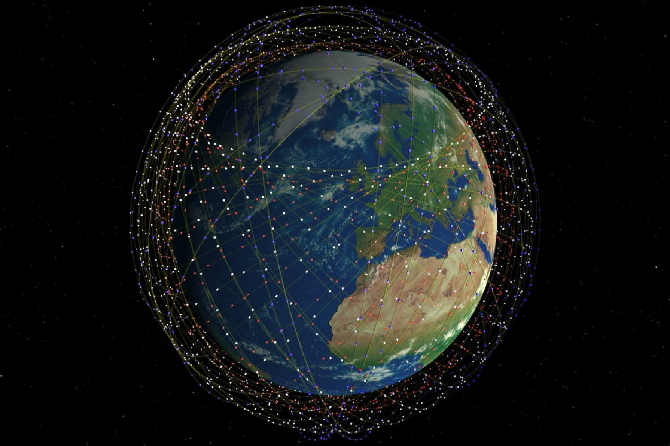
Constellation of satellites

Slide 5
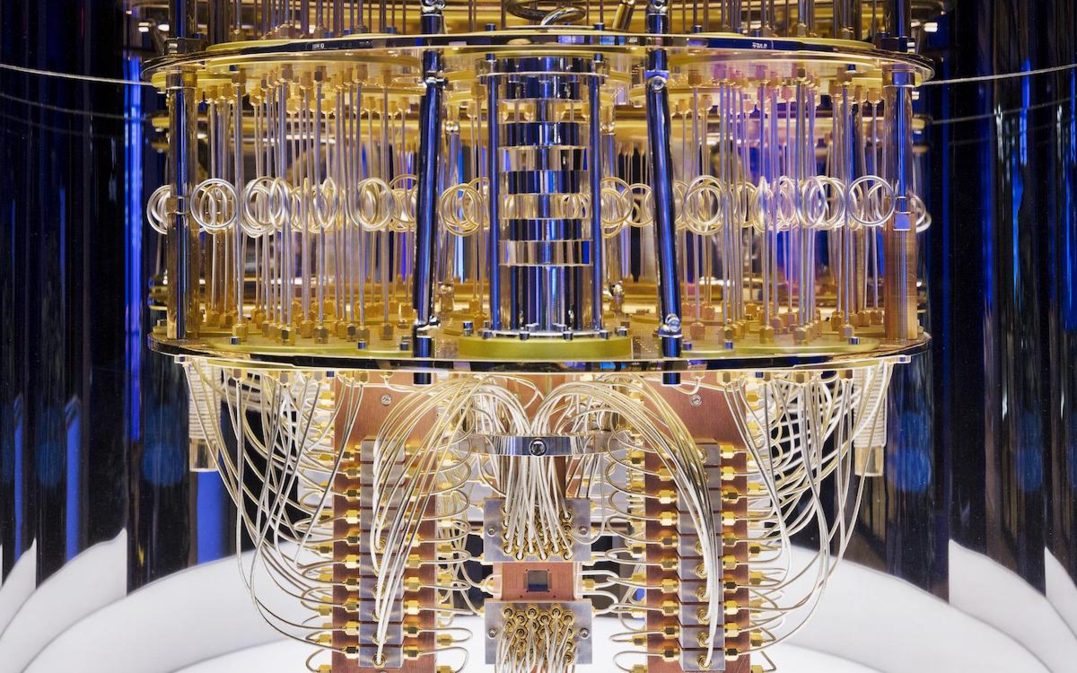
Quantum computer

Slide 6
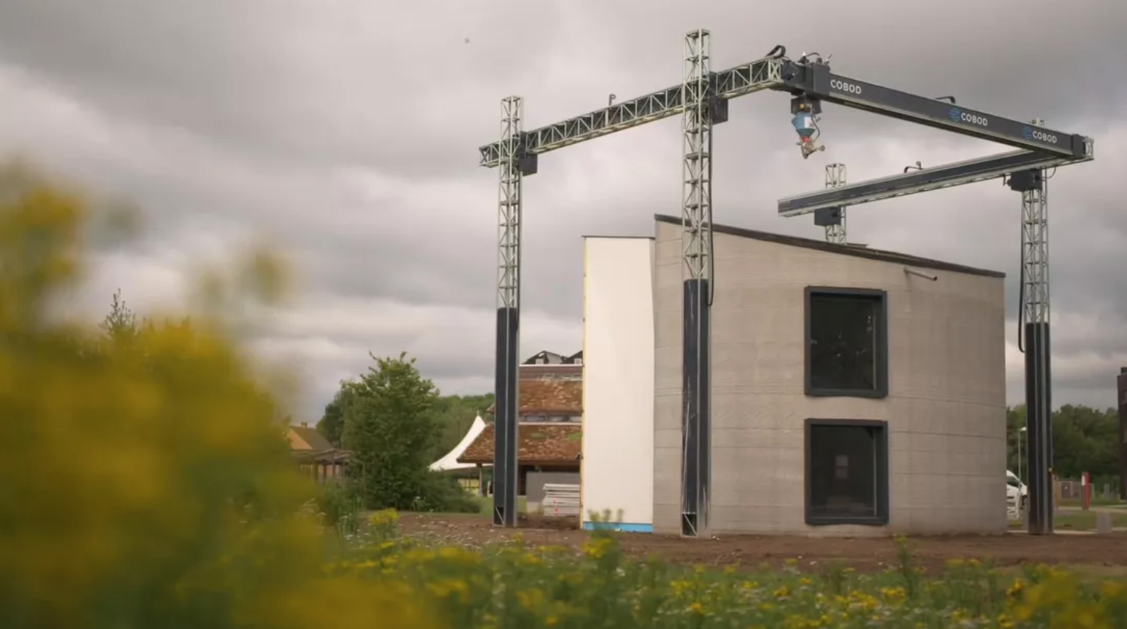
3D printer of houses

Slide 7
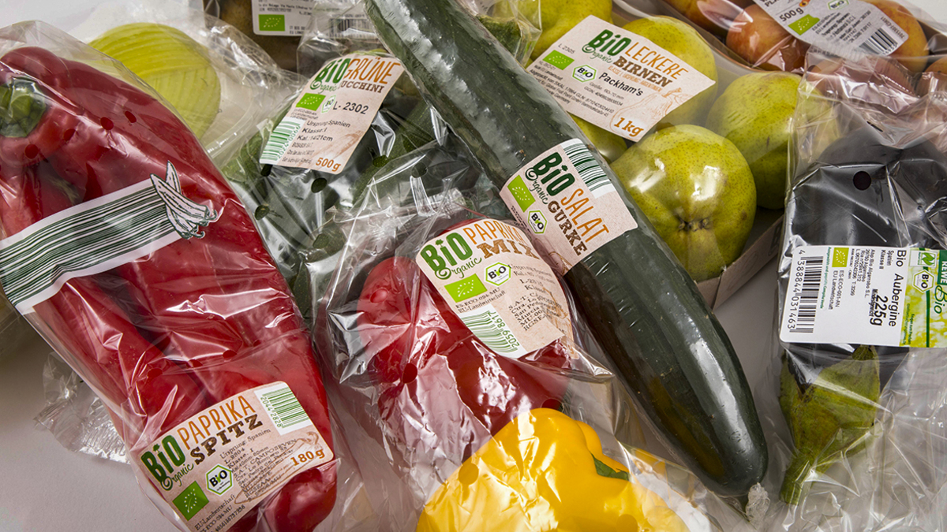
Bioplastic from plant waste

Slide 8
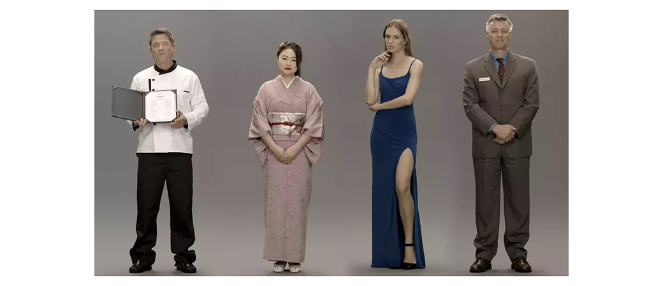
Artificial people Neon from Samsung

Slide 9
Conclusion
In the very more interesting idea of technology

Slide 10
Questions
Who want create constellation of satellites?
Where created a 3D printer of houses?
Are the people Samsung projects real?

Slide 11
Bibliographic list
MIT назвал 10 технологий 2020 года, которые изменят будущее (electronic resource) URL:https://incrussia.ru/news/mit-top-10/
3D принтер домов (electronic resource) URL:https://architime.ru/news/kamp_c/3d_printed_two_story_house.htm#2.jpg
Десять инновационных технологий, которые изменят нашу жизнь (electronic resource) URL:https://trends.rbc.ru/trends/innovation/5df26cc19a79477250ac8483
ТОП-20 технологий будущего из CES 2020 (electronic resource) URL:https://ilounge.ua/review/top-20-tehnologij-buduschego-iz-ces-2020

Slide 12
Thank you for your attention

